Slide 1

FOREIGN AVAILABILITY DETERMINATION
PROCEDURES & CRITERIA
October 29, 2019
Orestes Theocharides
Office of Exporter Services
Bureau of Industry & Security
U.S. DEPARTMENT OF COMMERCE

Slide 2
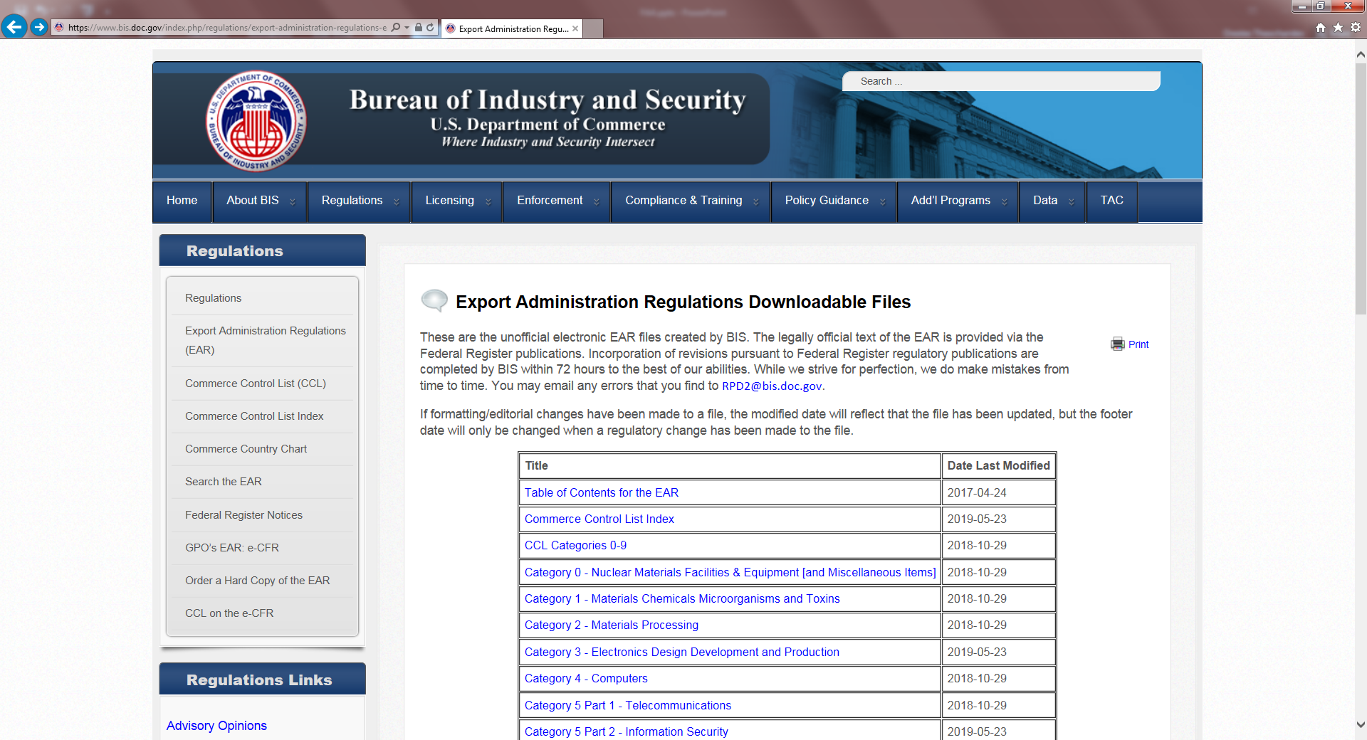
https://www.bis.doc.gov/index.php/documents/regulation-docs/432-part-768-foreign-availability-determination-procedures-and-criteria/file

Slide 3

■ Foreign Availability to Controlled Countries
■ Foreign Availability to Non-controlled Countries
► Decontrol Assessments
► Denied License Assessments
NATIONAL
SECURITY
CONTROLS
► Decontrol Assessments
► Denied License Assessments
► Expedited Licensing

Slide 4
CRITERIA TO ASSESS FOREIGN AVAILABILITY
Available-in-Fact from Non-U.S. Source
  Caveat: Except to non-controlled countries if item is available only under national-security license from country with export controls on such items cooperatively with U.S.
Sufficient Quantity (not a criterion for expedited licensing)
  To render U.S. control ineffective
  For controlled country: quantity that meets its military needs
Comparable Quality
  Function, technology, performance, service life

Slide 5
Initiation Countries Determination
TAC Controlled 90 Days from Initiation
Claimant Controlled & 5 Months from Initiation
(not a TAC) Non-controlled
DOC Secretary Controlled & Promptly
Non-controlled
Foreign Availability claim from TAC, or Claimant, for Expedited Licensing: Determination made within 30 days of Initiation

Slide 6
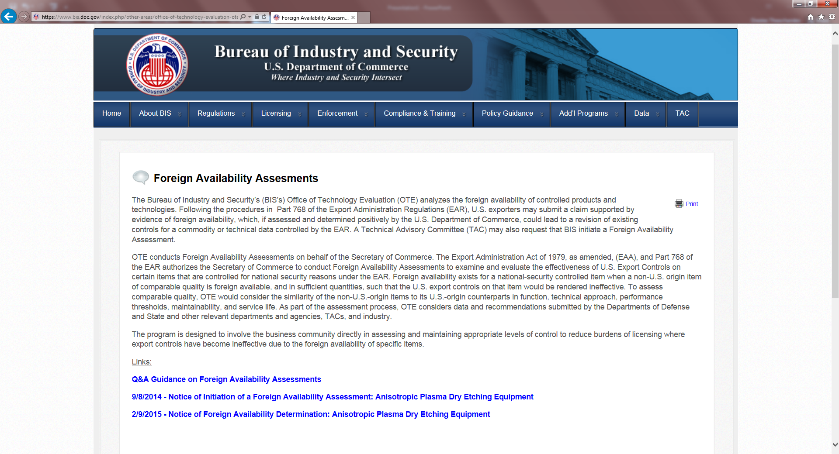
https://www.bis.doc.gov/index.php/other-areas/office-of-technology-evaluation-ote/foreign-availability-assesments

Slide 7
THANK YOU!
Orestes Theocharides
Senior Export Compliance Specialist
Bureau of Industry and Security
U.S. Department of Commerce
Washington, D.C. U.S.A.
(202) 482-3405
Orestes.Theocharides@bis.doc.gov

