Slide 1
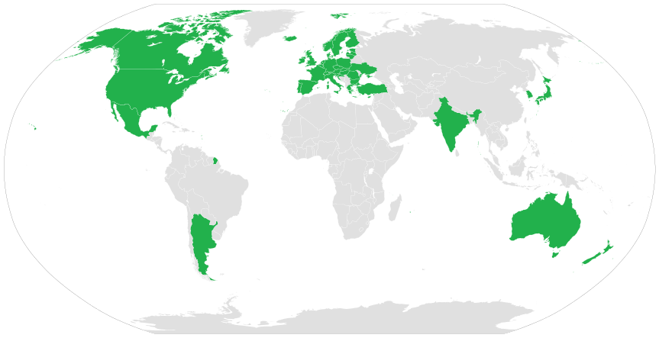
Australia Group
Overview
Wesley Johnson, PhD
Microbiologist
Chemical and Biological Controls
Bureau of Industry and Security

Slide 2
Australia Group
42 member states and the European Union
Like-minded approach to prevent proliferation of chemical and biological weapons
Common Control Lists
“No undercut” policy on denials

Slide 3
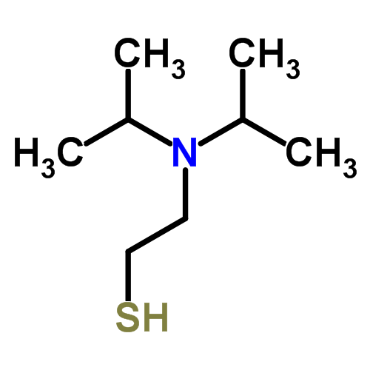

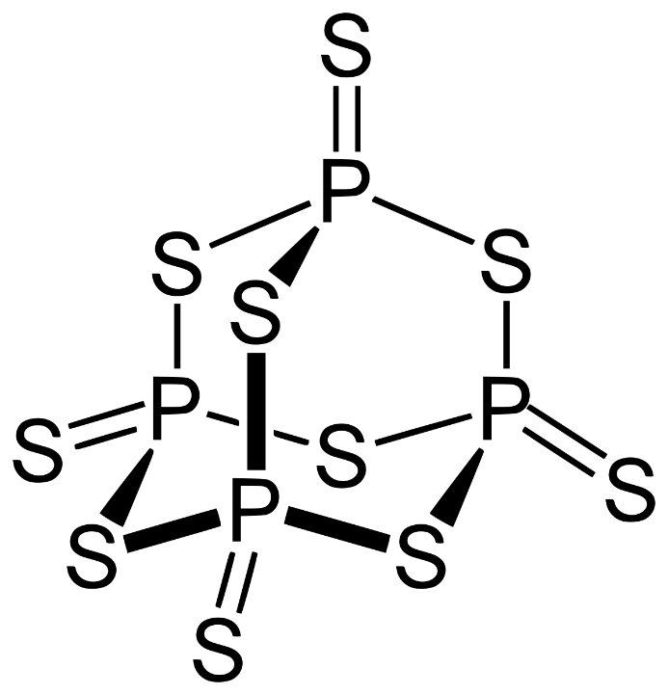
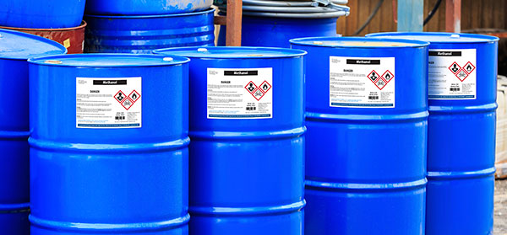
Common Control Lists
Chemical Weapons Precursors (related technology) – ECCNs 1C350, 1C355, 1C995 (1E001, 1E351, 1E355)

Slide 4
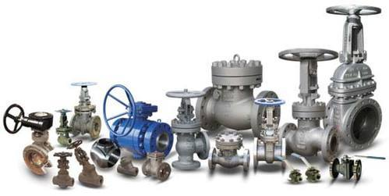
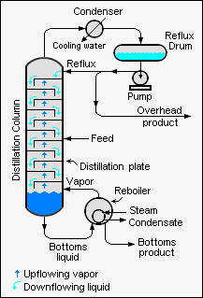
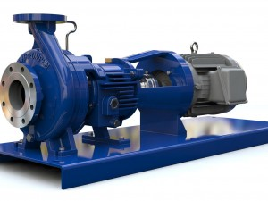

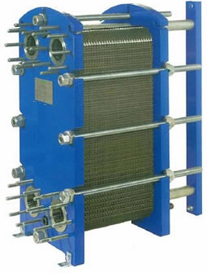
Common Control Lists
Dual-use chemical manufacturing facilities and equipment (related technology and software) – ECCNs 2B350, 2B351, 1A004 (2D351, 2E001, 2E002, 2E301, 2E351, 1D390, 1E350)

Slide 5
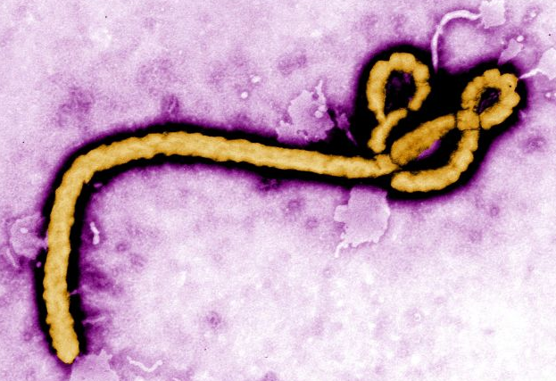
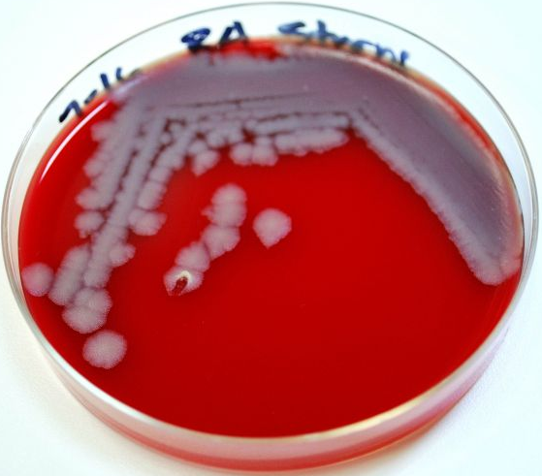
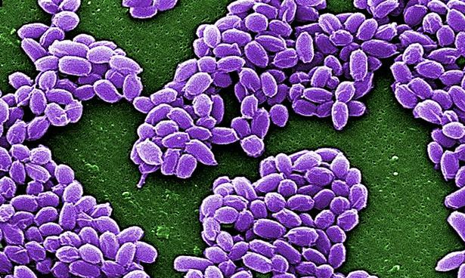
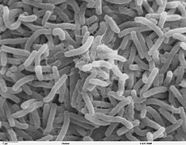
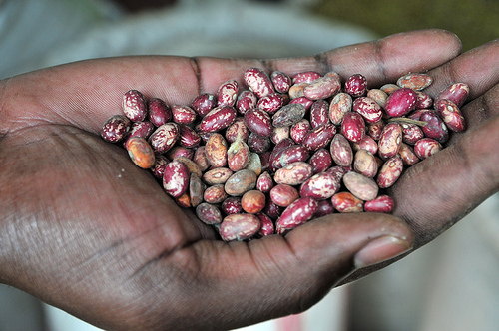
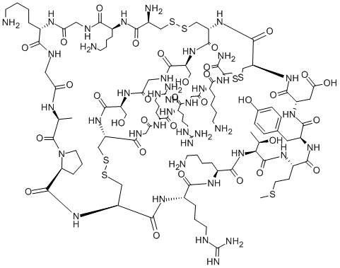
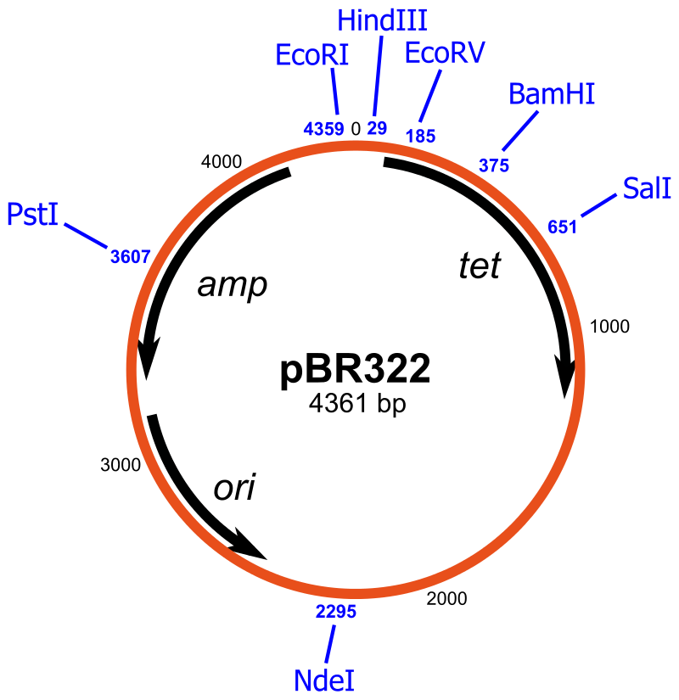
Common Control Lists
Human and Animal Pathogens and Toxins (related technology) – ECCNs 1C351, 1C353 (1E001, 1E351)

Slide 6
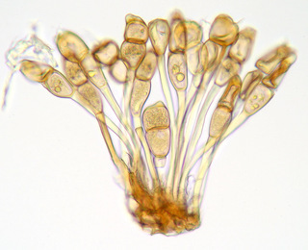
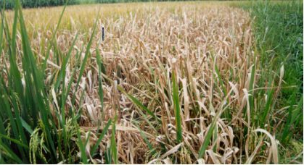
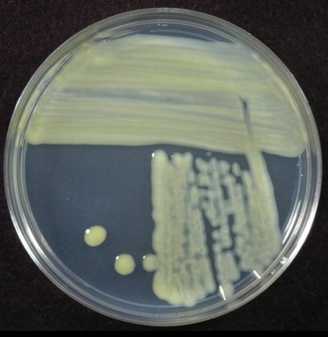
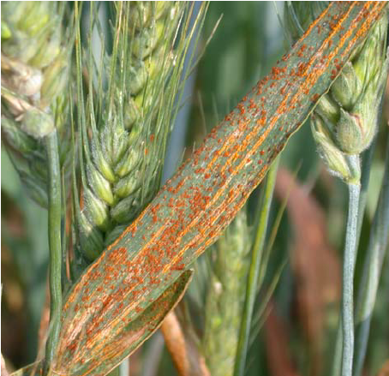
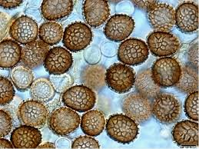
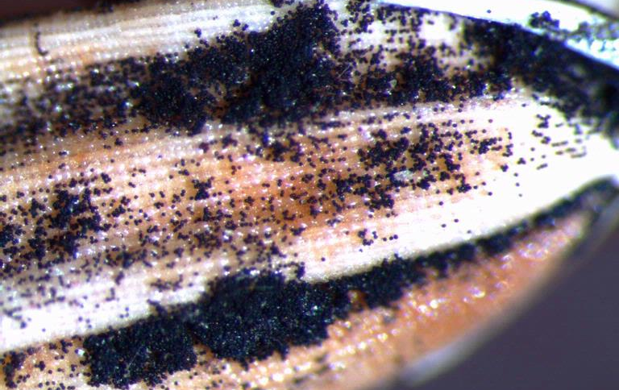
Common Control Lists
Plant pathogens (related technology) – ECCN 1C354 (1E001, 1E351)

Slide 7
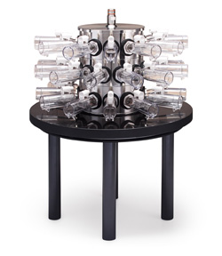
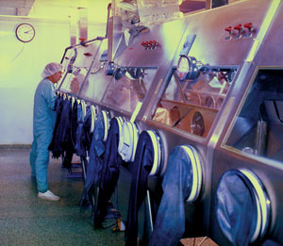
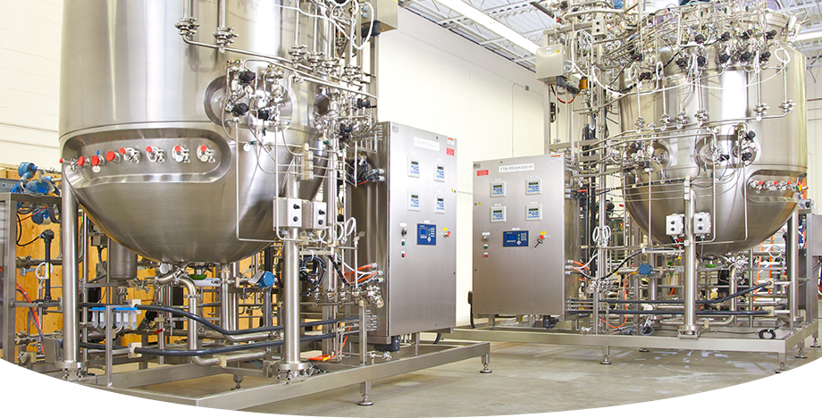
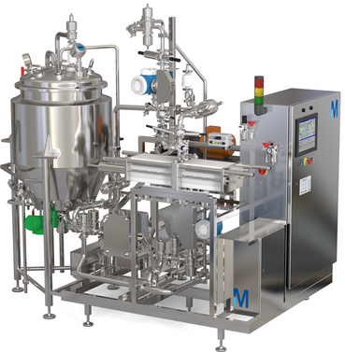
Common Control Lists
Dual-use biological equipment (related technology and software) – ECCN 2B352 (2E001, 2E002, 2E301, 2E321)

Slide 8
Australia Group meetings
Plenary meeting every June
  Implementation meeting (control list changes)
  Information exchange
  Enforcement exchange (case studies)
Intersessional meeting most years (Dec-Mar)
  Implementation meeting (control list changes)
  New and Evolving Technology Technical Experts Meeting (NETTEM)

Slide 9
Process
Identify items to be added, deleted, or edited
Discuss implications of changes for individual member states and industry (Virtual Working Groups)
Changes must have consensus
30 day silence procedure for adoption
Publication in regulations of member states

Slide 10
Identifying Issues
Control List reviews
Novel applications or improvements for existing items
New technologies or commodities
Unusual classification or licensing cases
Interpretation surveys by AG members

Slide 11
Typical Process for List Changes
No further action
Regulatory issue
(gap, “loophole”, outdated language, unnecessary control)
Present
Implementation
Meeting
Advise
Virtual Working Group
Update
30 day silence procedure
Formal proposal
Official List Change

Slide 12
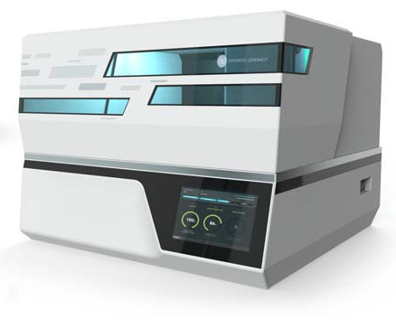
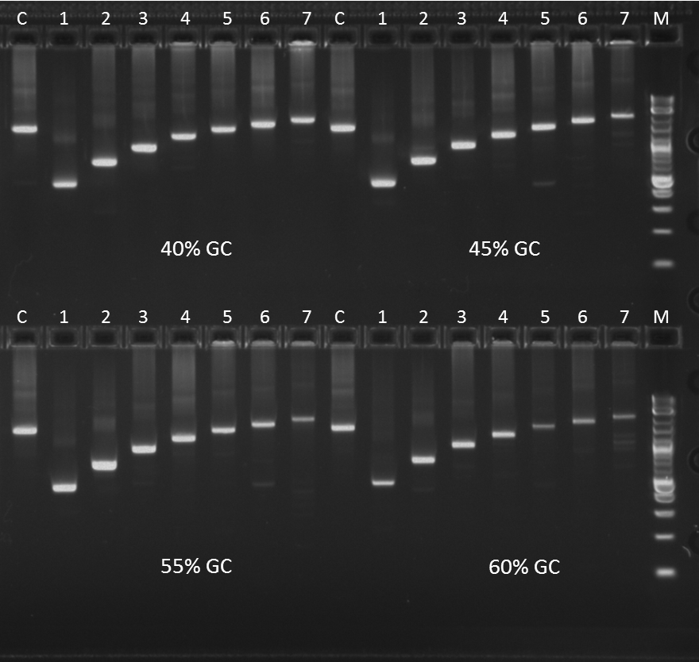
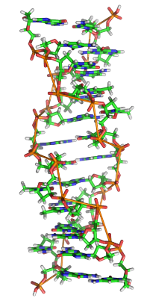
Case Study – Addition of DNA synthesizers
Digital sequence data
…AGAAGCCCTAGCTAGCCATATCGCCCTATCTTAAATTTATTAAGCGCCGAT…
DNA Synthesizer
DNA (full length, functional gene)

Slide 13
Case Study – Addition of DNA synthesizers
Timeline
Manufacturer USG-wide
compliance review
May 2014
NETTEM
Chair’s VWG
Feb 2016
Consensus at
Intersessional Meeting
Feb 2017
Published Rule
83 FR 13849
Apr 2018
Manufacturer asked
to present to AG
Aug 2015
Plenary Formal
Proposal
June 2016
Adopted by 30 day
silence procedure
Mar 2017

Slide 14

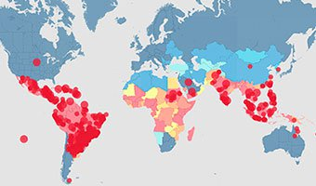
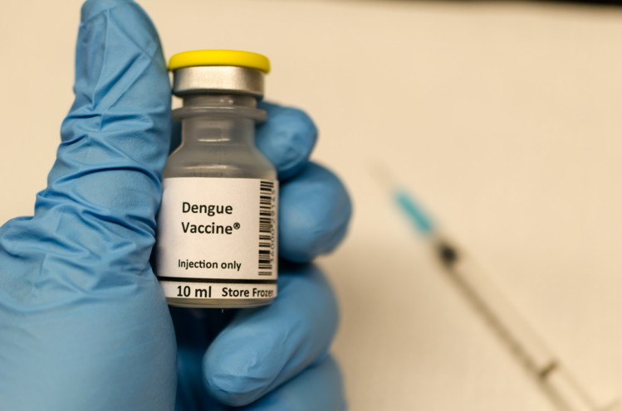
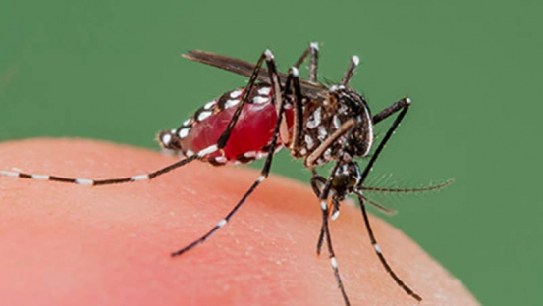
Case Study – Delisting Dengue Fever Virus

Slide 15
Case Study – Delisting Dengue Fever Virus
Timeline
Start of vaccine
clinical trials
Jun 2011
First successful
Vaccine trial results
Nov 2015
Consensus at
Plenary Meeting
June 2016
Published Rule
81 FR 90983
Dec 2016
Nonpaper reviewing
Dengue virus at IIM
Jan 2015
IIM Formal
Proposal
Feb 2016
Adopted by 30 day
silence procedure
July 2016

