Slide 1
Nuclear Suppliers Group
Keeping Controls Updated and Relevant
Presented by Steven Clagett
Director, Nuclear and Missile Technology Division
Bureau of Industry and Security

Slide 2
NSG Background
Founded in 1974
Group of countries that seeks to contribute to the non-proliferation of nuclear weapons through the implementation two sets of guidelines/lists
  Nuclear transfers (Trigger List)
  Nuclear-related dual use items
48 Participating Governments (PGs) that implement the guidelines through national laws and practices

Slide 3
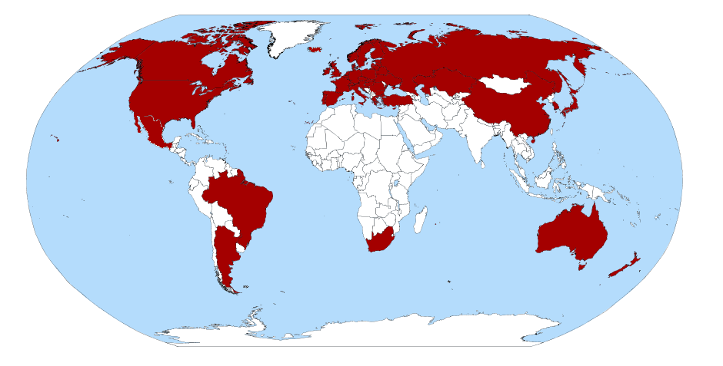
NSG Meetings
Annual plenary – held in early summer hosted by rotating (voluntary) chair
Consultative Group (CG) - meets twice a year to hold consultations on issues associated with the Guidelines on nuclear supply and its technical annexes
Technical Experts Group (TEG) – meets twice a year (usually in conjunction with CG) and is responsible for keeping the control lists technically accurate and up to date

Slide 4
Affecting Change in the NSG
Proposals to alter control lists are submitted by individual countries and must reach consensus to be adopted
Join Commerce Technical Advisory Committees (TACs)
Multinational companies should consult with other branches and make Commerce aware of any differences in how the control language is interpreted/implemented
Keep Commerce abreast of emerging technology or expanded uses of controlled items

Slide 5
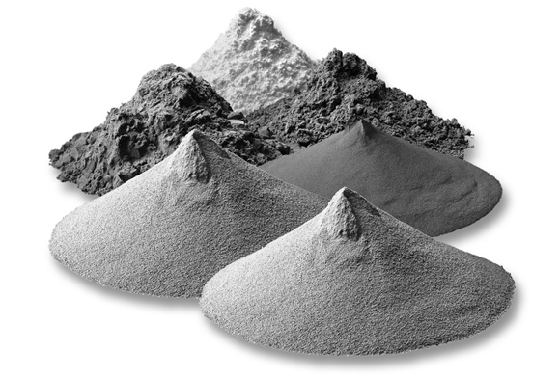
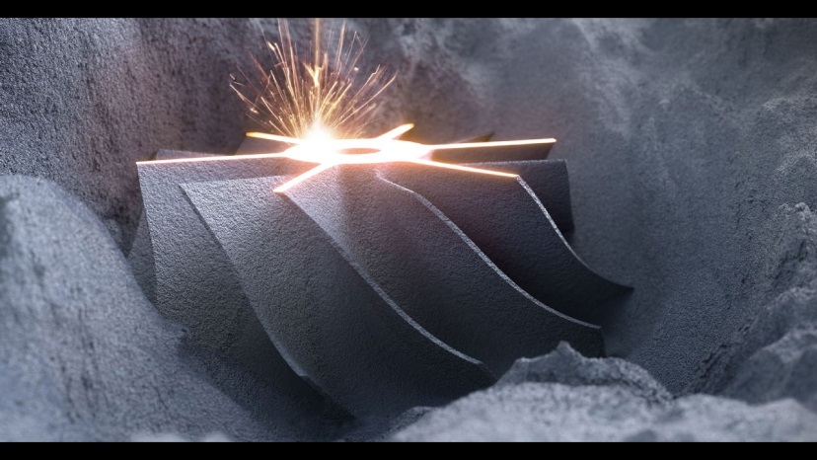
TEG Topics – Additive Manufacturing
“A New Way to do Old Things”
Additive manufacturing (AM) – what should be controlled versus what can be controlled
What about technology or materials?
How do you properly define machines – ISO standards, parameters, characteristics?
Job shops and parts by mail – is this a model for the future?

Slide 6
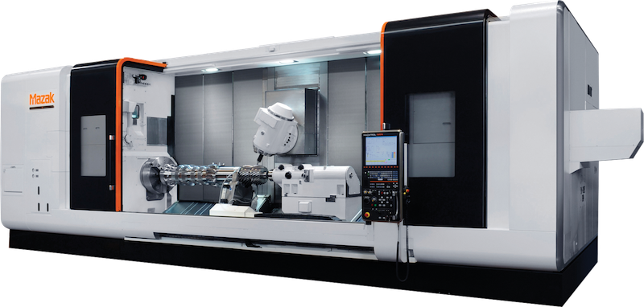
TEG Topics – Machine Tools
Machine tools have been a fixture of export controls for over 60 years. New ISO standards, growing world wide availability, and greater capabilities are forcing the NSG to determine not only what machines are “usable”, but what machines can realistically be controlled.
Are machine tool controls as relevant in light of emerging technologies such as AM or other casting techniques?

Slide 7
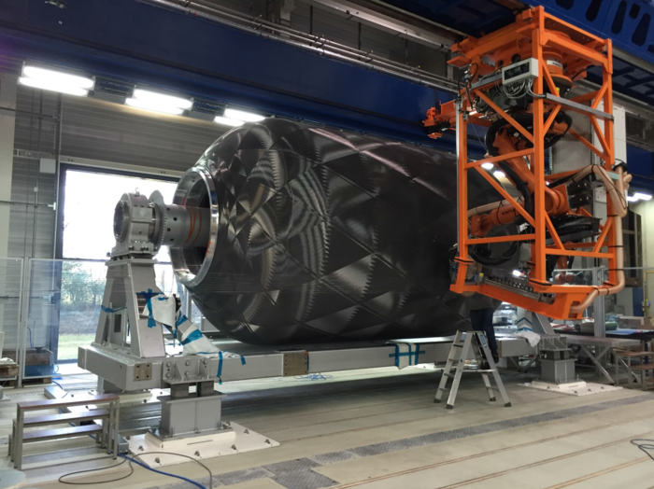


Future TEG Topics – Carbon Fiber?
Carbon fiber was once the exotic material of aerospace, rocket motor cases, and centrifuge rotors. Now many of these early fibers/grades are obsolete with newer and better grades commonly used in sporting good and automobile applications.
Given that these materials continue to have strategic applications, should the growing world wide availability and ever increasing civil and consumer uses force the NSG to look for innovative ways to address these concerns?

Slide 8
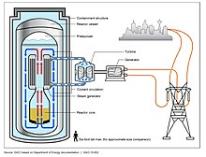
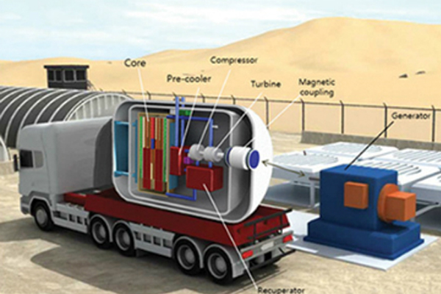
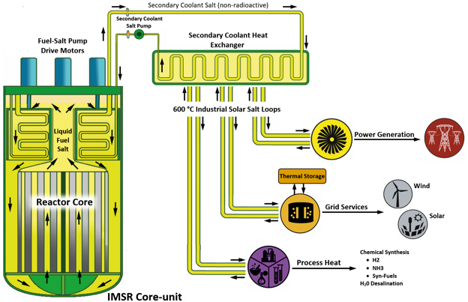
Future TEG Topics – Advanced Reactor?
Nuclear Reactors is one of the most significant items on the NSG Trigger List. They have been on the list since the beginning. However, new reactor types are coming off the drawing board. This raises some key questions:
Is the current language broad enough to capture new reactor technologies?
Are there any new materials, or especially designed components that need to be added

